Slide 1
Wiring
Electrical Systems

Slide 2
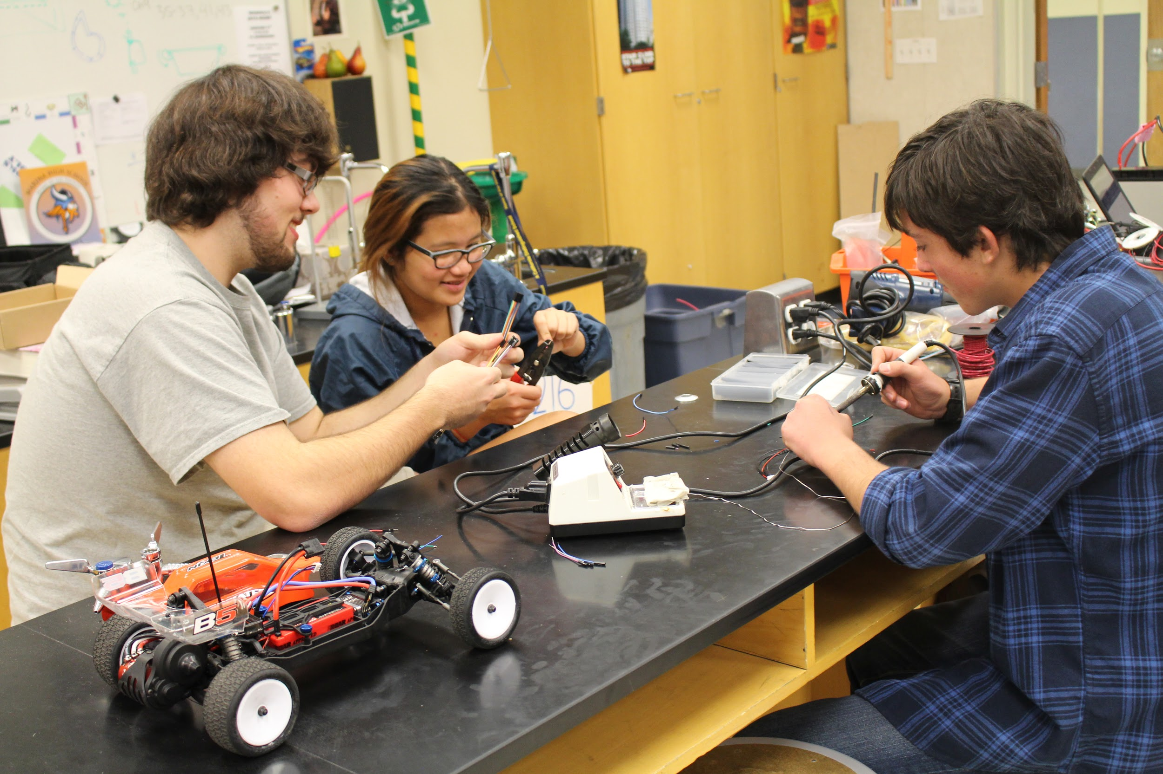

What is an Electrical System???
An electrical system are groups of electrical components to carry out some operation.
The electrical system distributes power to all components of the robot, including the controller, motors, sensors, and communications systems

Slide 3
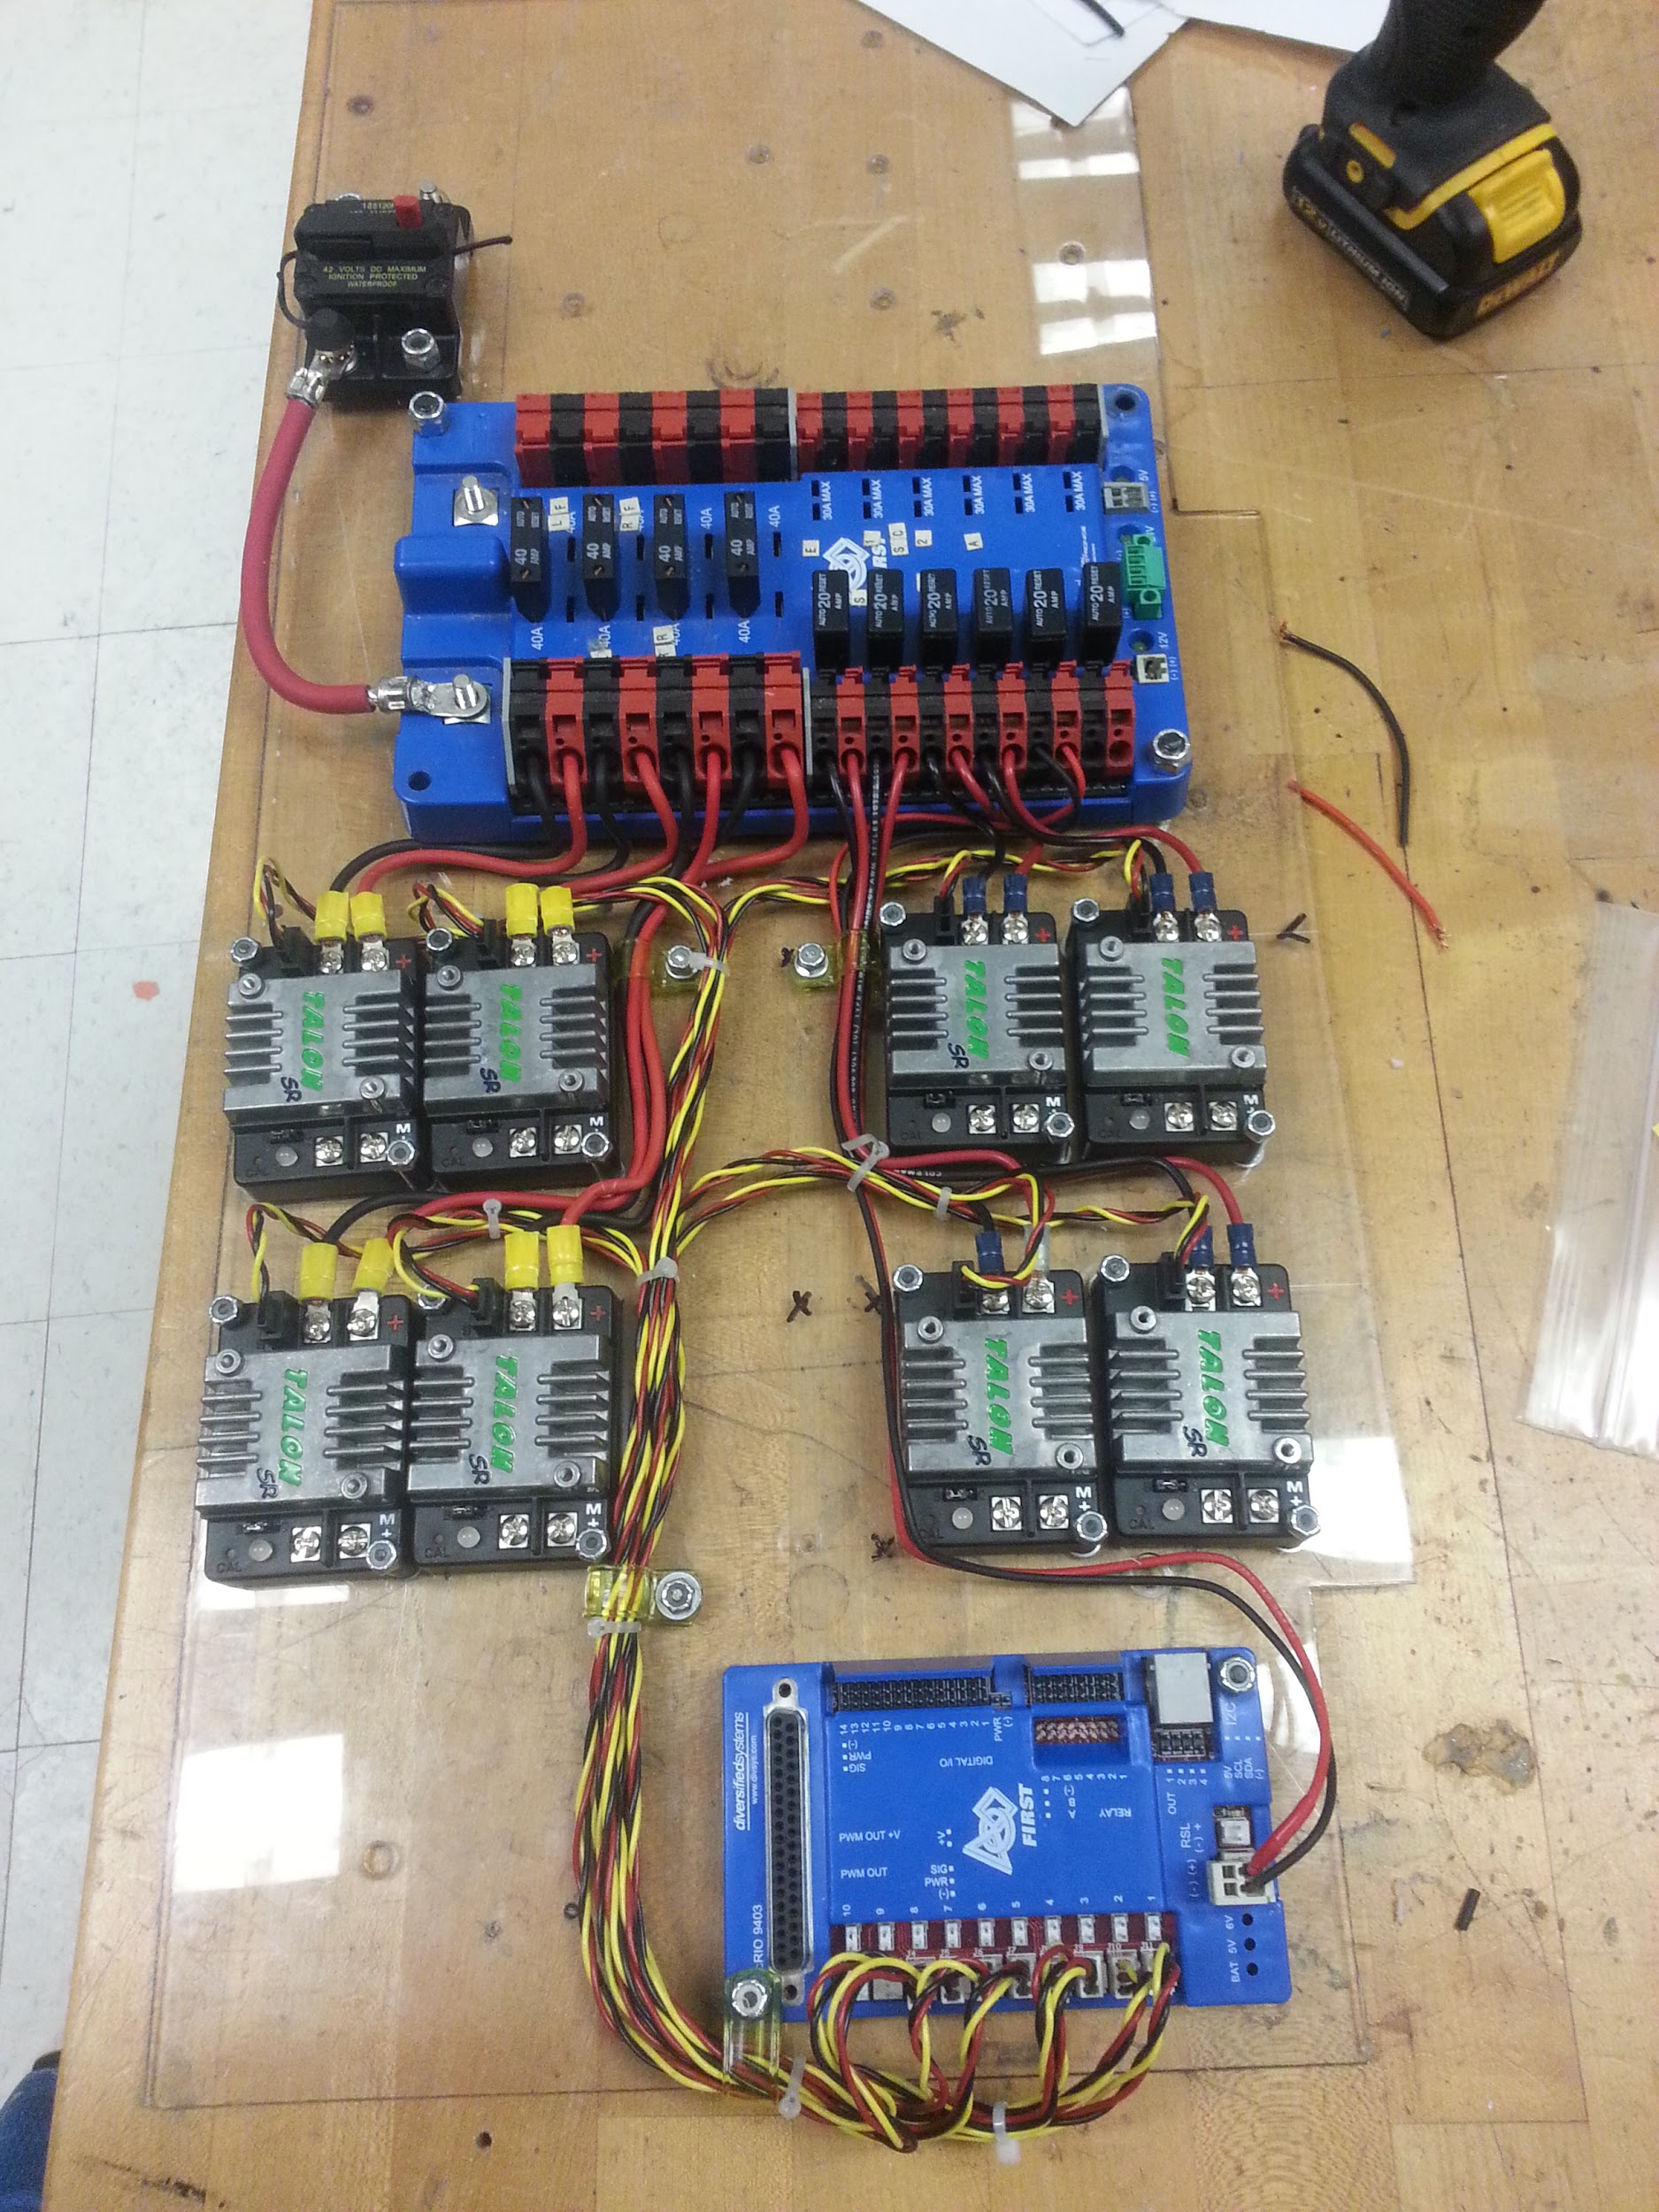
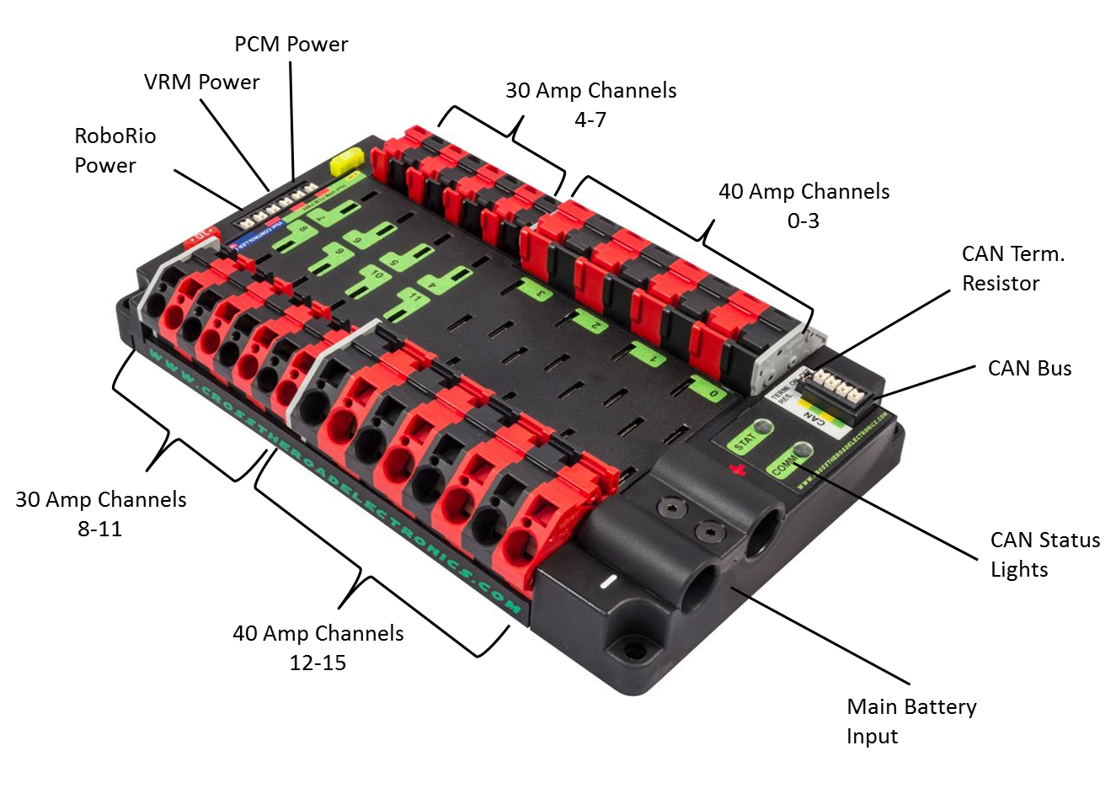
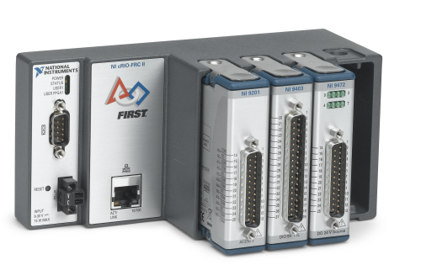
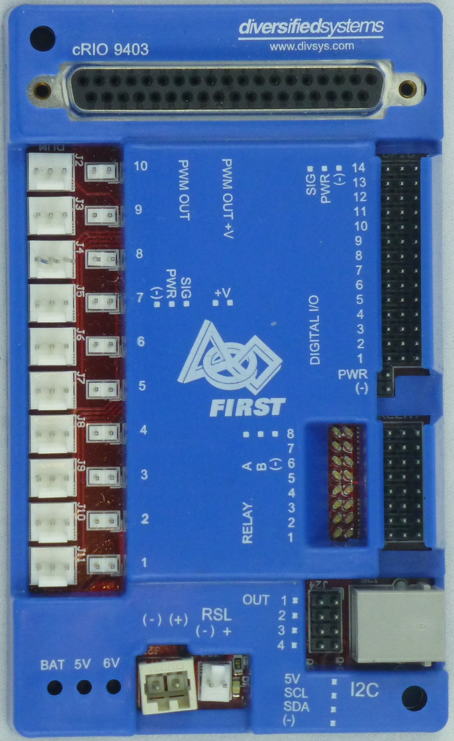
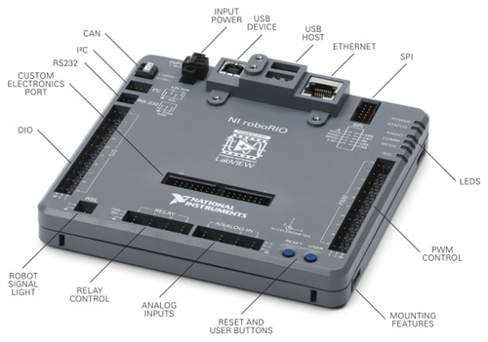
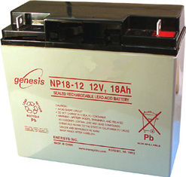
Parts you might find in a Electrical System:
Parts Link

Slide 4
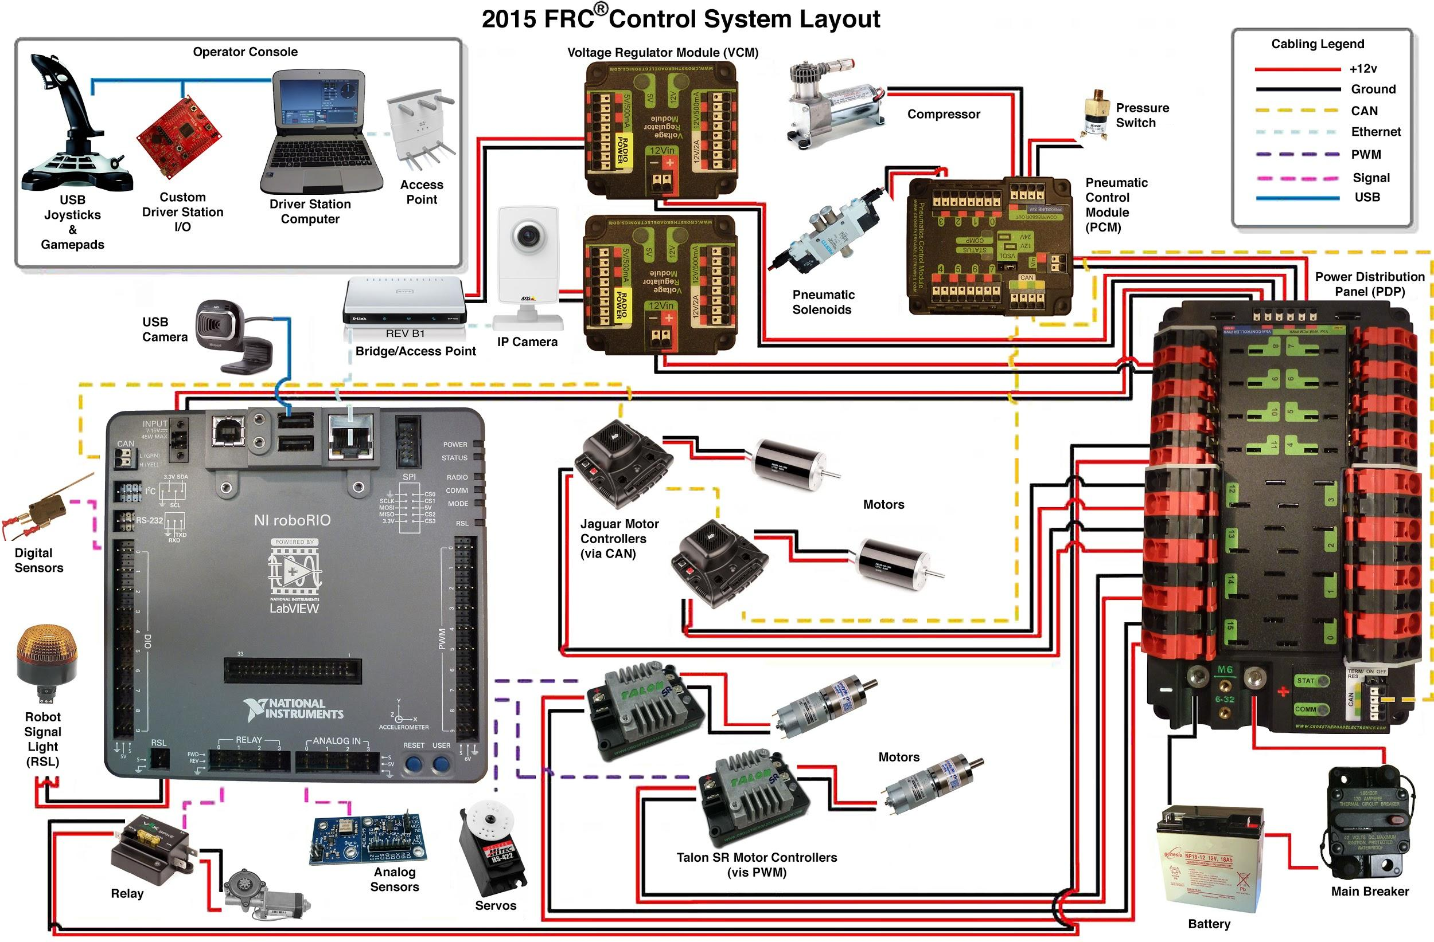

Slide 5
Power Distribution Board (PDB)
Important Stuffs:
AMP Channels (20, 30, & 40)
Main Battery Input
RoboRio Power
CAN Bus
PCM Power (Pneumatic Control Module)
VRM (Voltage Regulator Module)
The PDB provides power and acts as a single location for circuit breakers.
CAN Bus is a port that connects the PDB to the RoboRio ( It can also connect to the solenoid drive module). It sends data about currents and battery voltage to the computer.

Slide 6
RoboRio
Important Stuffs:
Power Input
Ethernet
CAN Bus
PWM Ports
DIO (Digital Input and Output)
Analog Ports
Reset Button
RSL (Robot Signal Light)
The RoboRio stores and executes the robot code. It is also connected to just about everything on the robot. (The Brain of the robot)

Slide 7
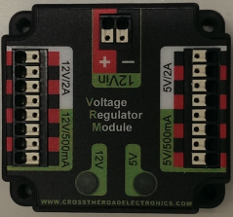

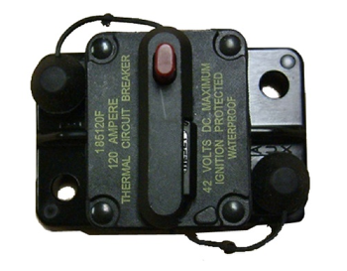
Power
To power the robot we use a 12 volt 18ah (amp hour) battery.
All of this power is distributed through the PDB.
The robot can be powered on and off with the switch.
The Voltage Regulator Module (VMR) allows access to different voltages to supply power to custom circuits, cameras, sensors, etc.

Slide 8
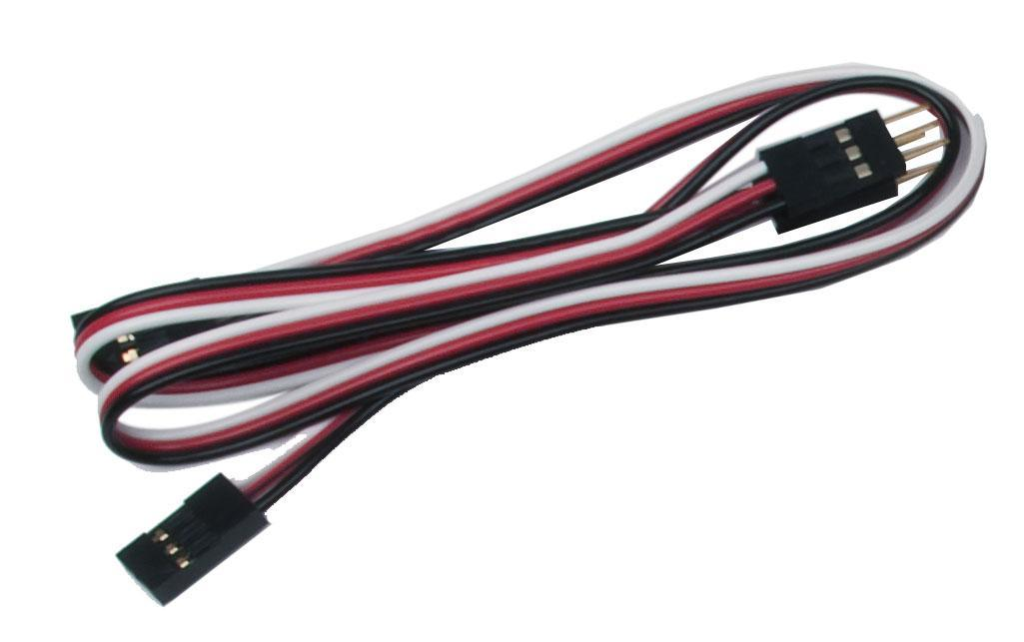
Pulse Width Modulation (PWM)
Pulse Width Modulation, or PWM, is a technique for getting analog results with digital means. Digital control is used to create a square wave, a signal switched between on and off.
White or yellow wire is signal, the red wire is power, and the black or brown wire is ground.

Slide 9
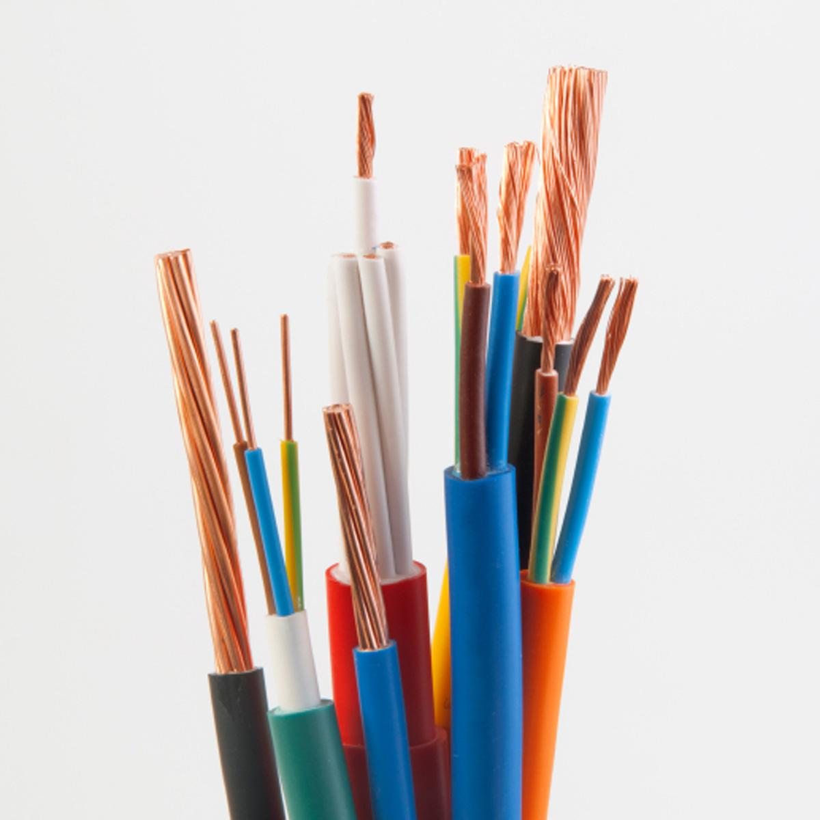
Wire Gauges
Gauge- The diameter of a wire.
The common wire gauges we use are 6 ga, 12 ga, 14 ga, 18 ga, and 22 ga.
6 gauge wire is the power wire.
12 gauge goes to the 40 amp breaker.
14 gauge goes to the 30 amp breaker.
18 gauge goes to the 20 amp breaker.
22 gauge are signals only.
Breakers prevent over currents, they allow up to 40 amps to go through then they shut off.

Slide 10
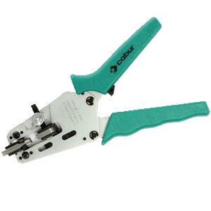
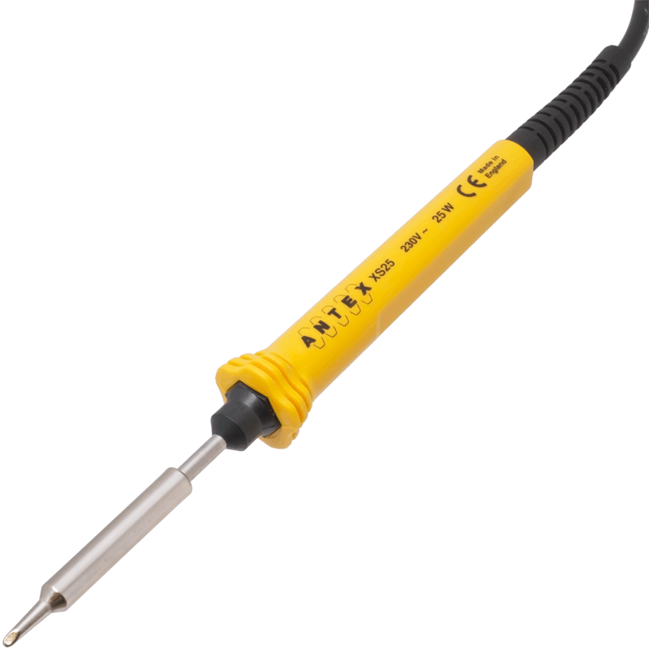
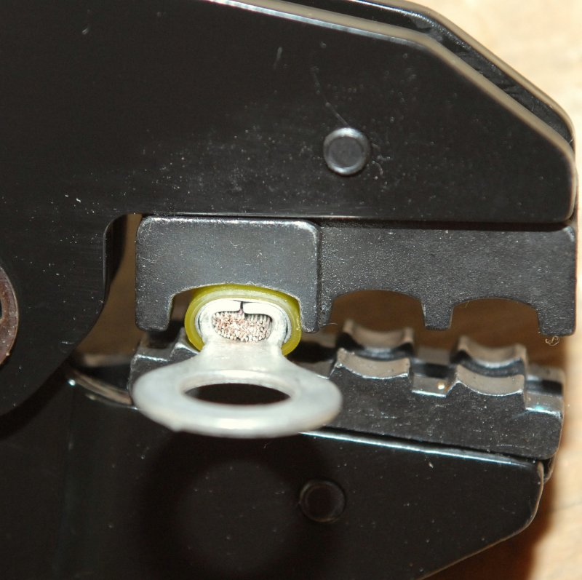
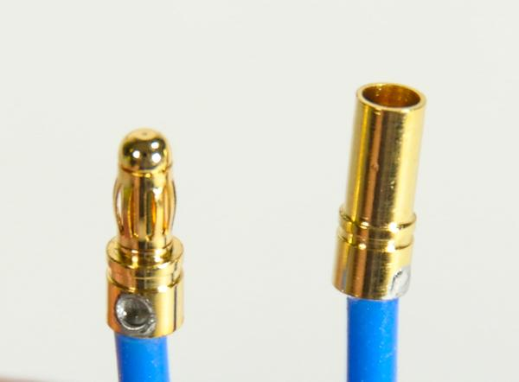
Crimps vs. Bullet Connectors
Crimping is compressing something into smaller folds or ridges.
Crimping is easy
Crimping is an alternative to soldering.
Bullet connectors are used the same way as crimps, but they are soldered on.
Bullet connectors don’t unplug as easily as crimps do.
They have a better connection, and look nicer

Slide 11
Questions???

